Slide 1
Presentation 11/03

Slide 2




Data discontinuity
Episodes don’t follow chronologically
Ep1: 399th frame Ep1: 400th frame Ep2: 1st frame Ep2: 2nd frame

Slide 3
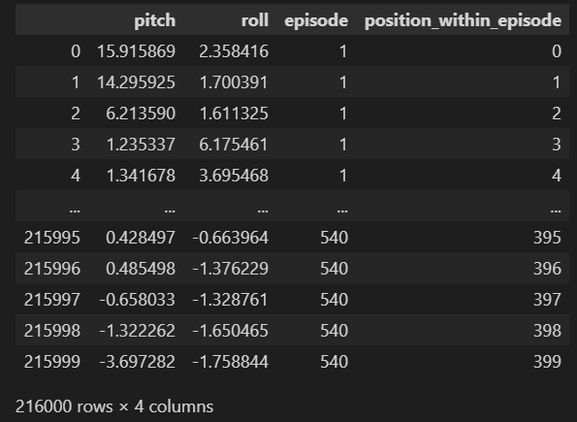
Data discontinuity
Episodes don’t follow chronologically
Add episode number & position
Batch size = 400?
Ep1: 400th frame Ep2: 1st frame

Slide 4
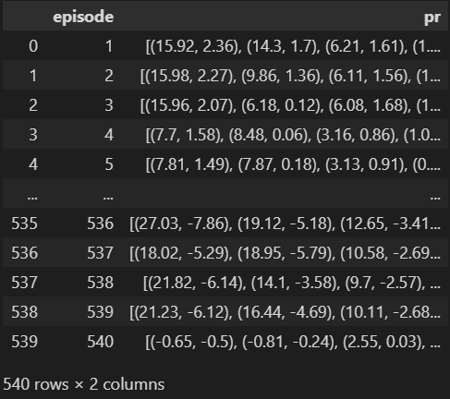
Data discontinuity
Episodes don’t follow chronologically
Add episode number & position
Batch size = 400?
Stack data: each row = 1 episode
Ep1: 400th frame Ep2: 1st frame

Slide 5
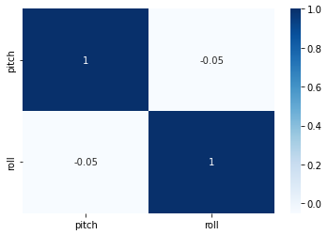
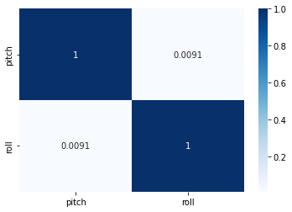
Data analysis
Low correlation between Pitch & Roll
Use both to predict both at the same time
Use both to predict one
One LSTM model for pitch, one for roll
Only use pitch to predict pitch, roll to predict roll
Episode 1 All episodes

Slide 6

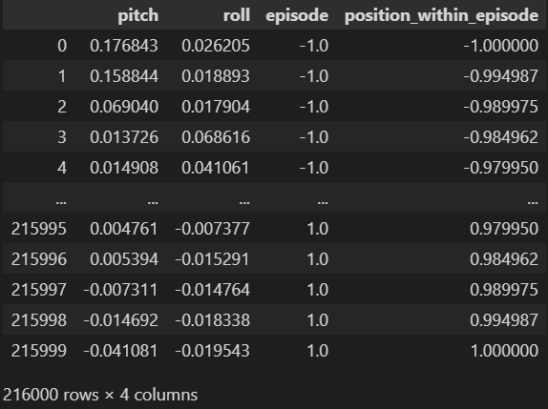
Multivariate single output LSTM model
Use P, R, episode and position to predict P
Normalized data
PR =
Episode & position
MinMaxScaler

Slide 7
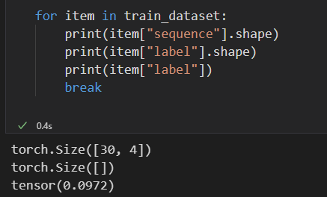
Multivariate single output LSTM model
Use P, R, episode and position to predict P
Normalized data
Sequence length = 30
Single Pitch value output
Not yet multi-step LSTM

Slide 8
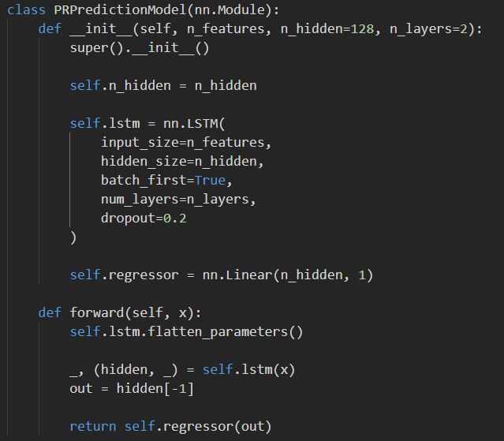
Multivariate single output LSTM model
4 input features
128 hidden features
Stacked LSTM
1 output value
MSE Loss for evaluation

Slide 9
Results
No results yet
Problems with datamodule/dataloader/…
Train_dataloader stuck in iteration
Above my capabilities
Multiple inputs, multiple outputs
hybrid models
encoder/decoder
discontinuous training data
lightweight, …
not just keras.VGG16(…)
Pytorch Udemy course

Slide 10
Planning March 2022
14/03-20/03
Continue Udemy course
Debug, train, test and evaluate LSTM PR model
21/03-27/03
Continue Udemy course
Create simple CNN model with only images
28/03-03/04
Train, test and evaluate CNN model
Combine with PR input
Hybrid with LSTM
Encoder-Decoder
Try to recreate Nazar’s best models if possible

Slide 11
Planning April 2022
04/04-10/04
Recreate Nazar’s best models
Train, test and evaluate with simulated (and real if available)
11/04-17/04
Debugging
Optimizing
Buffer for problems/delays occurred in previous weeks
18/04-24/04
Compare results simulation-real vs. criteria
Create new model if necessary:
Transformer model
25/04-01/05
Continue new model or optimize old model
Extensive testing

Slide 12
Planning May 2022
Depends on progression
Writing paper

Slide 13
Planning June 2022
Writing paper
Debugging
Optimizations

Slide 14
Comments
Select sequences in dataloader only from the same episodes
Batch size 60, sequence length 30,
2 seq/batch from different random episode
Test set for optimizations, validation set for final performance analysis
Pitch & Roll: angular = cyclical values: 359=-1°
Big impact on Loss
Use both pitch and roll to predict both
Testing, analysis
Prediction vs. truth
Prediction vs. error
Convergence, loss vs. epochs
MSE vs. #predicted frames
Roll MSE vs. Pitch MSE

